Slide 1
CENTRAL LINN
SCHOOL DISTRICT
Increasing Instructional
Time Committee
Student Representatives:
Emmie Helget
Lulu Howard
Maddy Howard
March, 2024

Slide 2
AGENDA
Problem Overview
What we trying to solve?
Process
Review the steps the committee took throughout our time
Consensus
How the Committee came to a single and final recommendation
Final Recommendations
Seeking Board Approval on four topics to increase time

Slide 3
Problem
Test
Scores
Test Scores: We reviewed data sheets that displayed how Central Linn was performing overall during the course of 4 years. Out of 5 levels, 1 being the lowest, Central Linn exhibited mostly 1 and 2 level scores.
Seat Time: We are meeting the bare minimum for hours required.
Preparation for Graduation: Central Linn students are poorly prepared when they leave Central Linn.
Bottom 10%: Central Linn is in the bottom 10% for graduation and test scores.
4 vs. 5 day week: Looking at research articles, the main idea presented was that schools with a 4 day week are more likely to have lower scores and are less prepared for the future than schools with a 5 day week.
4 vs. 5 day week
Seat time
Bottom 10%
Grad Rates and Prep

Slide 4
NEXT STEPS
OR MORE PROCESS
STEP ONE
BRAINSTORMING
STEP TWO
REVIEW DATA

Slide 5
NEXT STEPS
OR MORE PROCESS
STEP THREE
DISCUSSED OPTIONS
STEP FOUR
CAME TO A CONSENSUS

Slide 6
Coming to Consensus
What were our ideas?
How did we agree?
What do we need to solve?
Looked over school data over the past four year
Reviewed and talked about the struggles we want to see fixed
Voted and wrote pros and cons over our five recurring ideas
Narrowing down solutions and figuring out how that would work
After narrowing ideas, we voted and agreed on one singular plan
End: fist to five

Slide 7
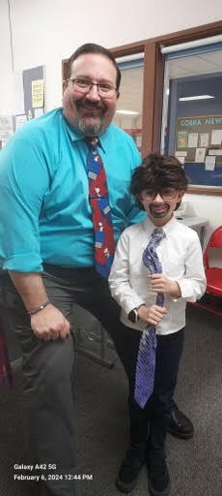
Solutions
Solutions

Slide 8
Committee Recommendation
Increasing Instructional Time Committee
Key Points |  | Changes
Restructure Fridays | Overwhelming data suggested groups approved of restructuring fridays | Fridays required for all students, but structure is different than current schedule
Enrichment and Interventions | Should have enrichment for everyone Should have intervention options for some needed | Include required core classes for students struggling Include various enrichment opportunities that includes student voice
Add Hours | All students will have more hours of instructional time each week | Increase days when possible, require Fridays for all students
Flexibility | Should offer flexibility for students who have jobs or take college courses | Provide credit and hours for work student and college

Slide 9
QUESTIONS?

